Slide 1

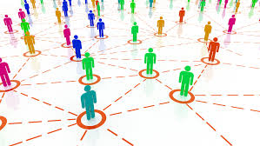





Integrative Genomics Approach to Computational Assessment of Threats (IGACAT)
Draft: a final version will be available at https://github.com/IGACAT/igacat.github.io
IARPA Fun GCAT W911NF-17-2-0105
Showcase
July 24, 2019
Stephen Eubank, PI
Andrew Warren, Co-PI

Slide 3
What is the general problem?
Given a set of user-defined categories:
Specified functionally (“Produces protein that causes severe cellular disruption”)_
Specified by example (“Gene XYZ is in category 2”)
and a short (50 - 200 bp) [nucleotide] sequence:
Possibly codon-optimized, disguised, chimeric, entirely novel
Categorize sequence and estimate confidence:
Optimize user-defined metrics (e.g., false positives for particular categories)
Confidence relates to probability category is correct
using limited computing resources
Time
Disk

Slide 4
What makes the problem hard?
Data: too much and too little
Too much: deep searches & combinatorial algorithms too expensive
Too little: need to impute features from a few examples
Open World
Unknown unknowns shrinking?
Known unknowns growing
Unknown knowns growing

Slide 5
What is the IGACAT solution?
Plug-and-play module for computer-aided sequence categorization:
Construct a knowledge base automatically.
Find relevant patterns using state-of-the-art techniques.
Enrich the knowledge base by propagating information.
Train predictors using advanced machine / statistical learning.
Adapt: Your problems are our problems.
IGACAT is the dashboard instrument cluster, not the self-driving car.

Slide 6
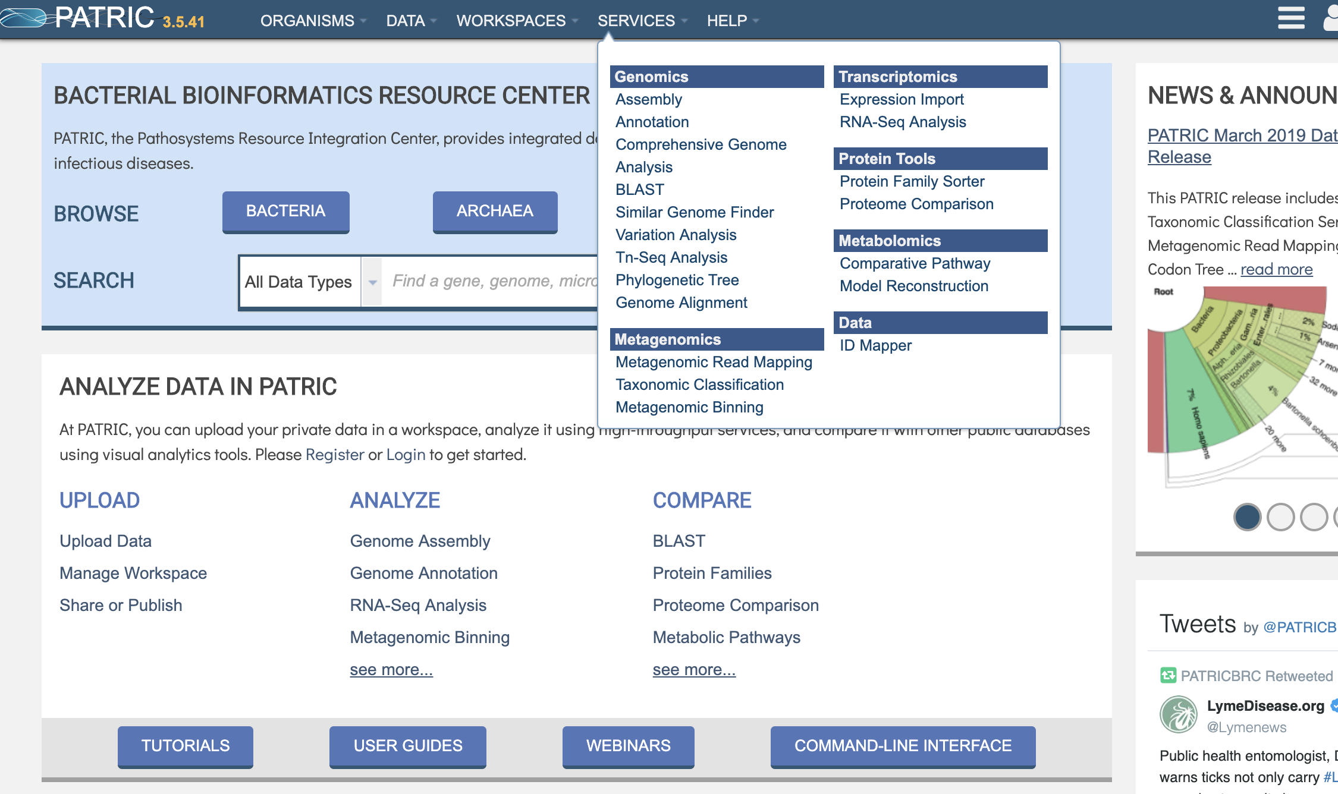
Modular design
Designed to be easily integrated
A component in a larger system
Can be adapted as a prediction service with a GUI
Singularity container for easy deployment and integration
CLI or API based interface that is easy to integrate into existing solutions and infrastructure
Flexible configuration; easy to add/remove modules
Integrates best of breed capabilities as well as custom models
High-throughput, parallel run model can be optimized to customer needs

Slide 7
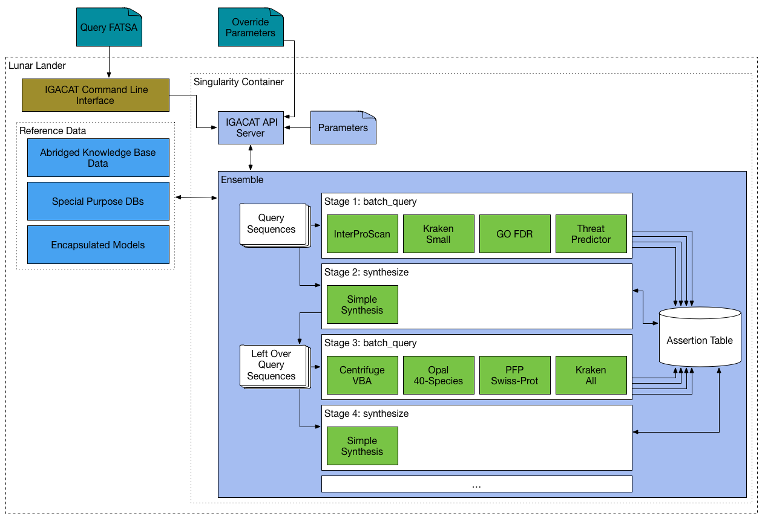
Cascading Workflows
Workflows can cascade into more expensive analysis for hard to characterize sequences
More sensitive search and analysis for high threat classes

Slide 8
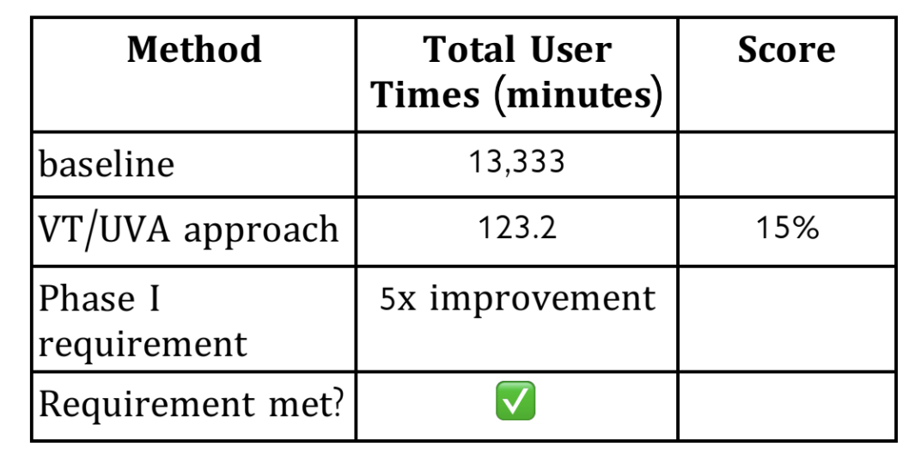
Invocation & Runtime
singularity run --app ensemble --bind /home/user/igacat_stage:/stage --bind /groups/fungcat/deployment_data:/referenceData igacat_server.simg -c 32 -p override-params.json -f test/sample3.fasta
sbatch -p smp_q --exclusive igacat-run.sh -f /home/dmachi/test_single.fasta -s /groups/fungcat/djm_results/
CPU hours 108X over baseline

Slide 9
Low Integration Overhead
,"kraken2_aa_all" : {
"module_name" : "kraken2_component"
,"class_name" : "Kraken2Component"
,"parameters" : {
"buildLocation": "bin"
,"db_name": "kraken2_aa_all"
,"confidence_threshold":0.0
}
}
Components consist of a python wrapper and a set of configuration parameters
Query components make assertions based on the query sequence
Synthesis components make assertions based on previous assertions
Can run more than once with different parameters (e.g. database)
,"centrifuge_vba" : {
"module_name" : "centrifuge_component"
,"class_name" : "CentrifugeComponent"
,"parameters" : {
"buildLocation": "src"
,"dbPrefix": "vba"
}
}

Slide 10
Data Integration
construct maintainable, replicable, enriched knowledge base of the world’s sequence information
apply HPC resources to most expensive operations: translating between systems of function description, identifying features, consolidating information, training models
Deployable System
include approaches that perform well in function prediction competitions
explore variety of machine learning methods with complementary strengths
Ensemble Modeling
outperforms single model on similar problems

Slide 11
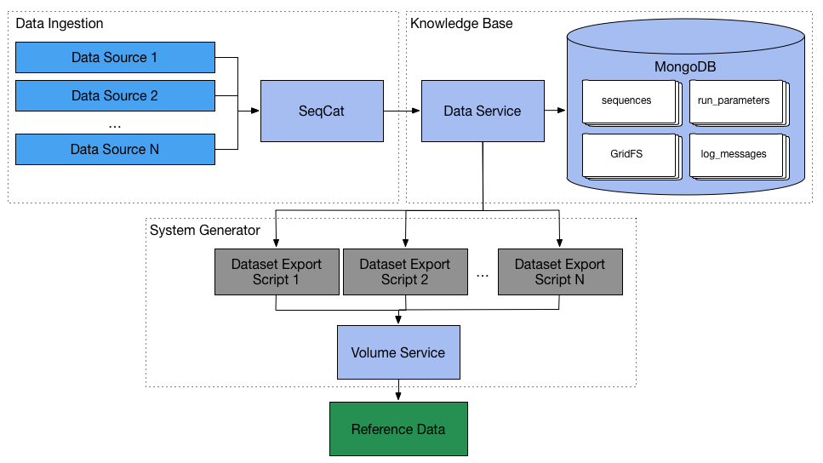
FunGCAT Knowledge Base
Customized DB for “joining” data about sequences
Consumes many public resources such as UniprotKB and PATRIC
Normalizes data attributes
Supports imputation of missing data
Exports JSONHFasta data for training and the run-time system
Places sequence features next to metadata, ideal for testing and machine learning
Easily adapted to custom assertions / annotations
Not directly part of the run-time system
Dynamic exports based on researchers’ requests

Slide 12
Why yet another knowledge base??
Coverage, e.g., protein coding or non-coding
Simplify and speed up queries
Accessible for enrichment, e.g., LD-50
Control update schedule
Control over feature imputation
Control over meta-data, e.g., KEGG pathways, orthologous groups

Slide 13
Features: inherent
Statistics on sequence as a string
length
entropy
GC content; k-mer distributions
Word2Vec embedding

Slide 14
Features: tags
Controlled vocabulary tags available in public databases:
Taxonomy: taxon:543 (entero-bacteria)
Gene Ontology: GO:0009045 (xylose isomerase activity)
UniProt keywords: KW-0800 (toxin)
UniRef similarity-based clusters: Uniref90_p0aes4 (DNA gyrase unit A)

Slide 15
Features: presence on lists
Lists of expert categorization: T3DB, DBETH, ConoDB, Arachno-Server, etc.
Select agents
Viral proteins
Pathogens
Toxins
Anti-Microbial Resistance

Slide 16
Features: clinical- & laboratory-determined properties
Published experiments
Natural language processing

Slide 17
Adding our own automatically generated feature: LD-50
Scan text, determine protein, parse units, determine experimental organism
Threshold into 4 toxicity bins
Result:
toxicity | # with known threat | KW-0800 | No threat | Mild threat | Moderate threat | Severe threat
Mildly toxic | 77 | 71 | 1 | 13 | 33 | 30
Toxic | 17 | 17 | 0 | 0 | 9 | 8
Very toxic | 30 | 29 | 0 | 0 | 6 | 24
N/A | 733,686 | 549 | 46 | 29 | 159 | 315

Slide 18
Feature extraction methods
Lasso (least absolute shrinkage and selection operator)
Individual mutual information
Expert opinion
Cross-validation model performance

Slide 19
Handling sparse data and the open world
Sparse data
Zillions of sequences (but strongly biased selection)
Few / no complete annotations
Few category examples
Little understanding of consequences of small mutations

Slide 20
Example training data set: too much and too little
Feature | Unique | Occurrences | Sequences
Taxa | 101,313 | 13,033,278 | 733,686
Keyword | 997 | 4,990,716 | 731,091
GO term | 28,827 | 36,085,369 | 694,825
IPR | 19,618 | 3,030,927 | 702,811
Uniref 90 | 709,180 | 733,686 | 733,686
LD-50 | 123 | 342 | 123
Threat category | 733,686
None | 710,198
Mild | 13,597
Moderate | 9,128
Severe | 763

Slide 21
Handling sparse data and the open world
Open world
New sequences
New & revised feature annotations
New terms in vocabulary
Categorization may change
Exponentially expanding literature

Slide 22
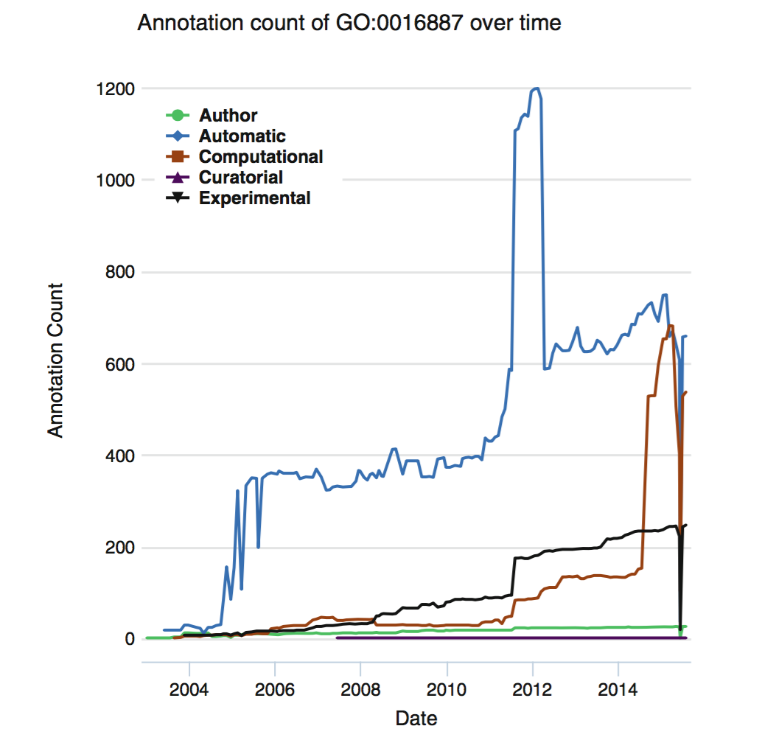
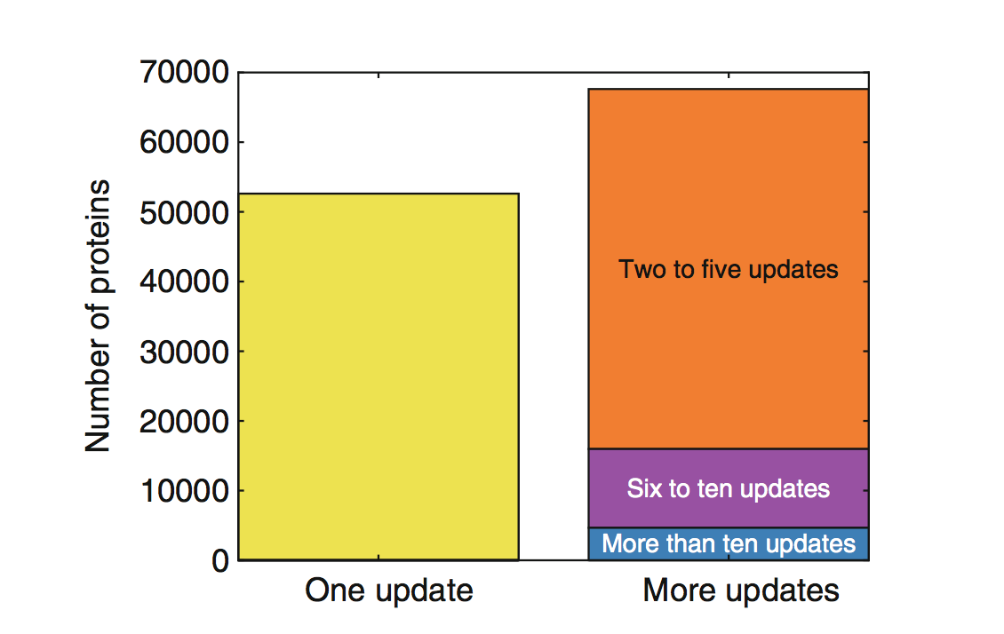
The Open World Issue
Curator revisits UniProt-GOA
(ATPase activity) UniProt-GOA
Gaudet, Pascale, Nives Škunca, James C. Hu, and Christophe Dessimoz. 2017. “Primer on the Gene Ontology.” In The Gene Ontology Handbook, edited by Christophe Dessimoz and Nives Škunca, 25–37. New York, NY: Springer New York. doi:10.1007/978-1-4939-3743-1_3.
Warren, Andrew, and João C. Setubal. 2012. “Using Entropy Estimates for DAG-Based Ontologies.” In ISMB Bio-Ontologies 2012. http://arxiv.org/abs/1403.4887.
Notes:
“The absence of evidence is not the evidence of absence.” Annotations are always in a state of incomplete knowledge.
For the proteins already present in the UniProt-GOA database, we see that curators do revisited them; more than half of the proteins have already been assigned a new GO term annotation after their first introduction into the database
Changes in annotation frequency can come from changes in the ontology structure by automated methods. This will impact the knowledgebase. Assesment of performance should attempt to account for this.

Slide 23
Two approaches to enrichment
Sequence -> function -> phenotype in vivo
From first principles not in the foreseeable future
Propagating information using
Machine / statistical learning models
Based on sequence similarity

Slide 24
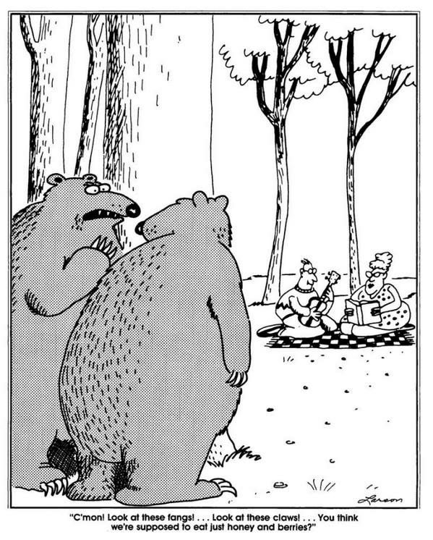
Imputing features using sequence similarity
But,
“as few as five amino acid substitutions … may be sufficient to confer airborne transmission” of highly pathogenic avian flu
“Airborne Transmission of Influenza A/H5N1 Virus Between Ferrets”, SANDER HERFST, et al., SCIENCE22 JUN 2012 : 1534-1541
C’mon! Look at these fangs GO terms!... Look at these claws taxon ids!... You think we’re supposed to eat just honey and berries?
24

Slide 25
Machine and statistical learning methods
Deep learning (artificial neural networks)
General linear models
Random forests
Heterogeneous ensemble techniques
Histograms (!?)

Slide 26
Task-specific imputation / classification requirements drive research
Characterizing sequences
Select most likely reading frame
Detect codon optimization
Detect viral sequences
Detect house keeping genes
Classify protein domains
Novel methods
Plinko: Hierarchy of neural nets for HMM matching
Not-so-naïve Bayesian inference: combinatorial consistency criteria

Slide 27
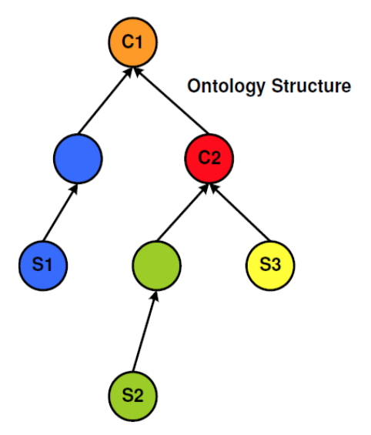
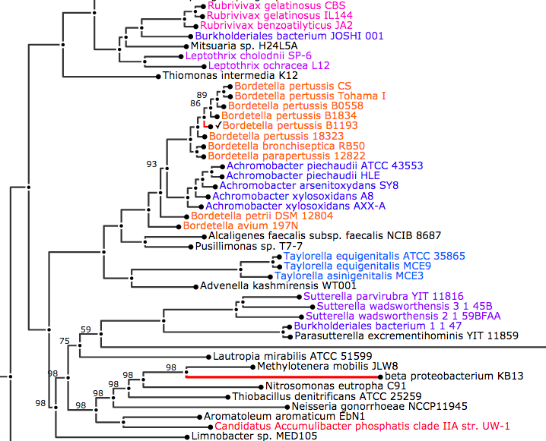
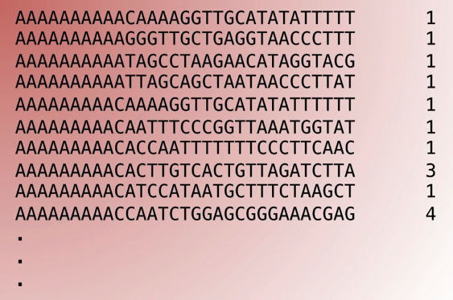
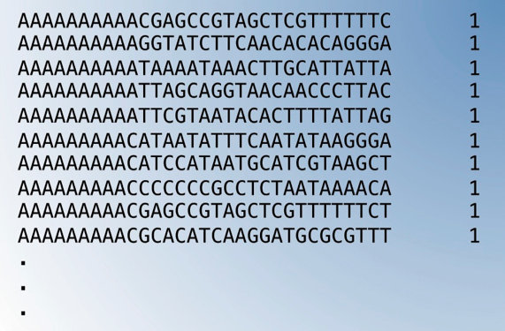
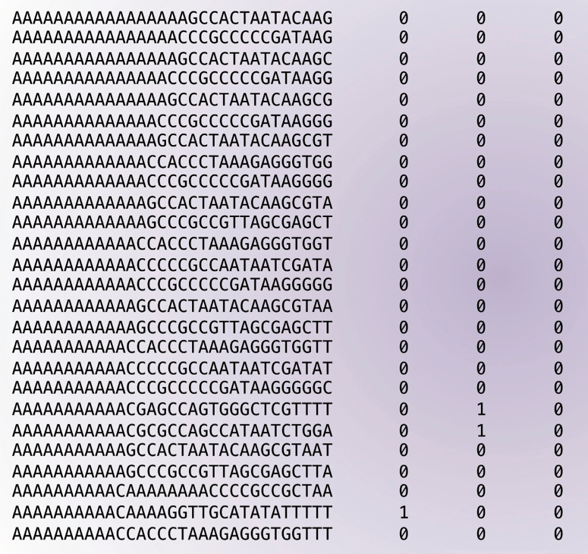
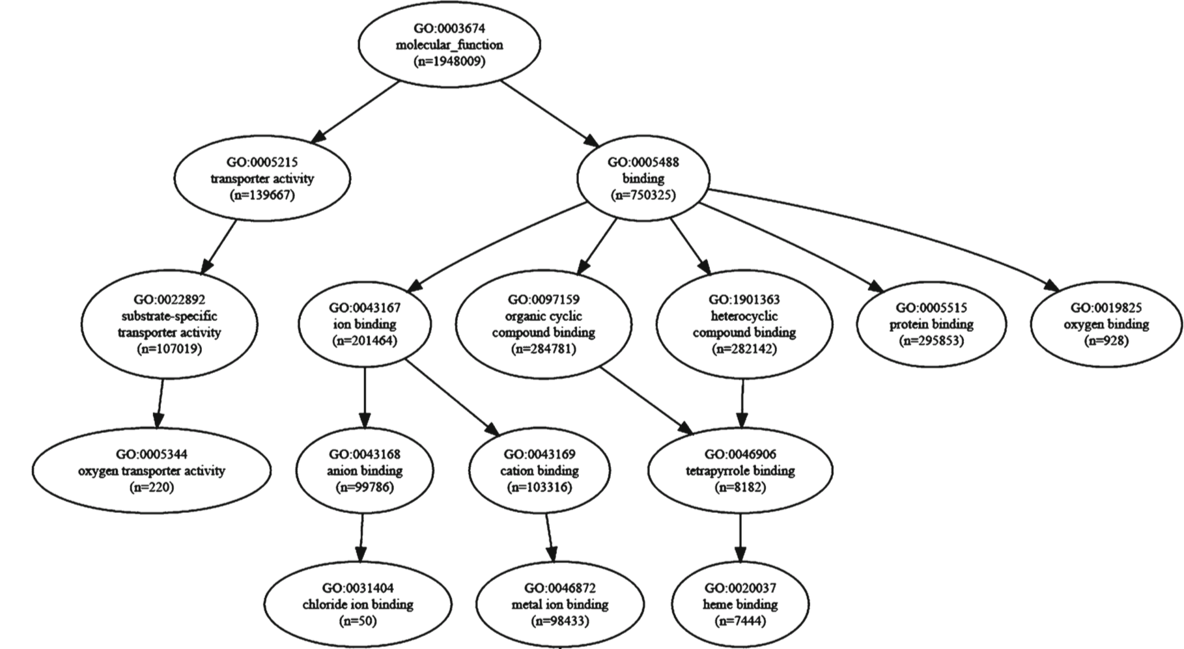


Putting it all together
Knowledge Base
Predicted Features
Threats
Non-threats
Query sequence
Prediction
Methods
Search Space
Categorization
Annotation
Indexing
Prediction
Methods
Threat Status
Notes:
Both the green and the orange represent areas for computation/prediction. The orange represents a richer context and heavier compute since we know the source organism, location in that organism, etc. The green is the “run-time” compute that needs to be optimized for performance.

Slide 28
Result: IGACAT is the law clerk, not the jury
IGACAT sifts through case history to find relevant cases.
IGACAT marshals evidence for and against.
IGACAT draws out the implications of the evidence.
IGACAT explains its conclusions in terms of relevant features.

